Slide 1
AI & Big Data Analytics for Society

Slide 2
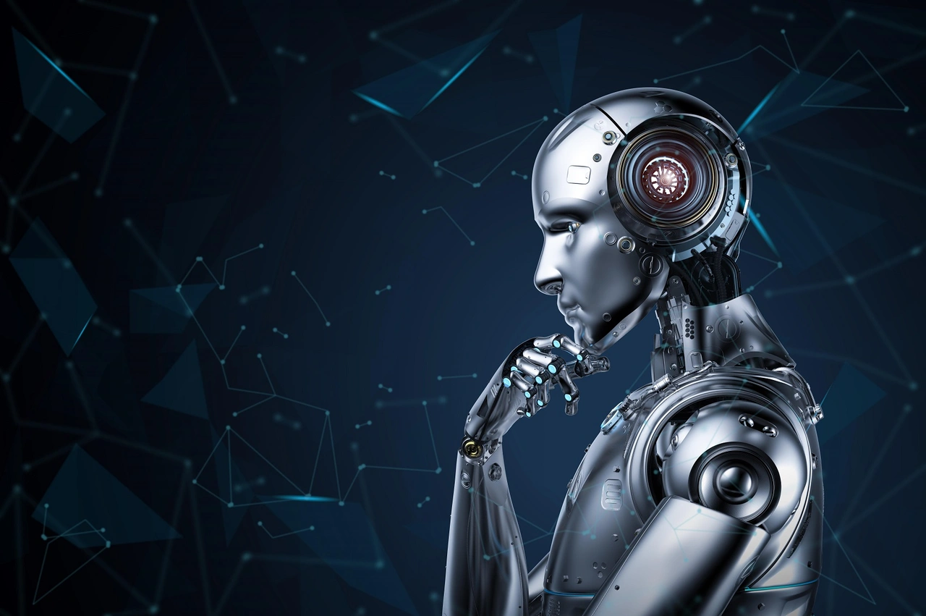
Artificial Intelligence (AI)
The ability of machines to think like human intelligence

Slide 3
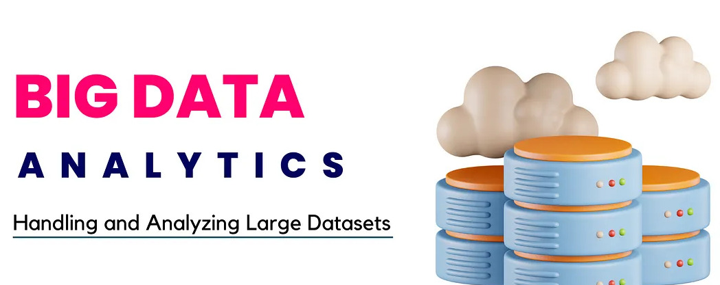
Big Data Analytics
The process of analyzing large datasets to extract insights and patterns

Slide 4
General vs Narrow AI
General AI: Capable of performing any intellectual task like a human.
Narrow AI: Specialized in a specific task, such as image recognition or NLP.

Slide 5
Fields of AI
Image Processing
Computer Vision
Robotics
Natural Language Processing (NLP)
Expert Systems
Machine Learning & Deep Learning

Slide 6
Supervised vs Unsupervised vs Deep Learning
Supervised Learning: Uses labeled data for training.
Unsupervised Learning: No labeled data, finds hidden patterns.
Deep Learning: Uses neural networks for complex problem-solving.

Slide 7
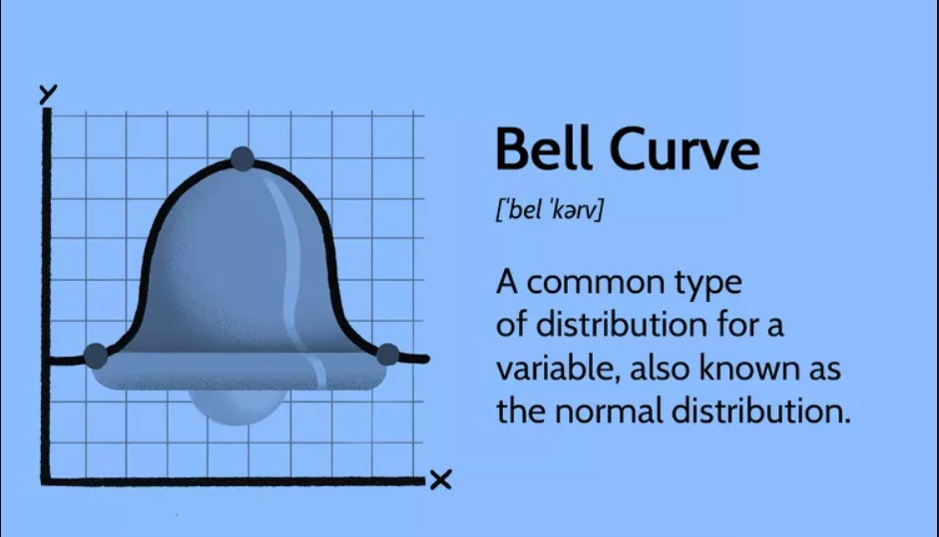
Probability Distributions
Normal: Bell-shaped, used in statistics.
Example of Probability Distribution: Rolling a die (values: 1, 2, 3, 4, 5, 6)

Slide 8
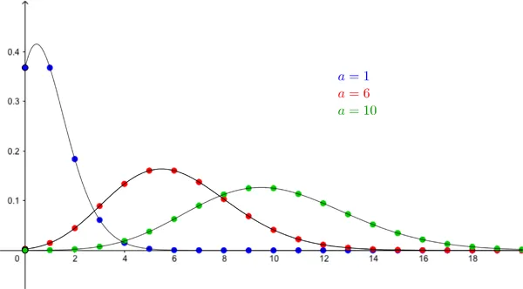
cont……
Poisson: Reference to Models rare events.

Slide 9
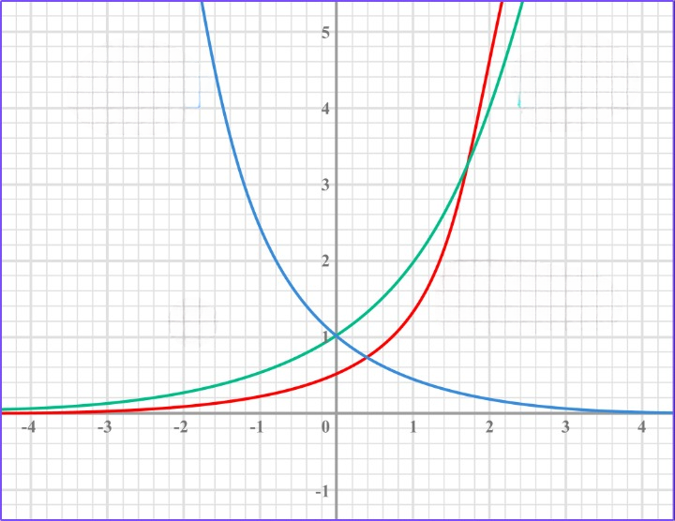
cont…..
Exponential: Time between events in a Poisson process.
Ex:
1) Time until a radioactive particle decays
2) Time between customer arrivals at a store

Slide 10
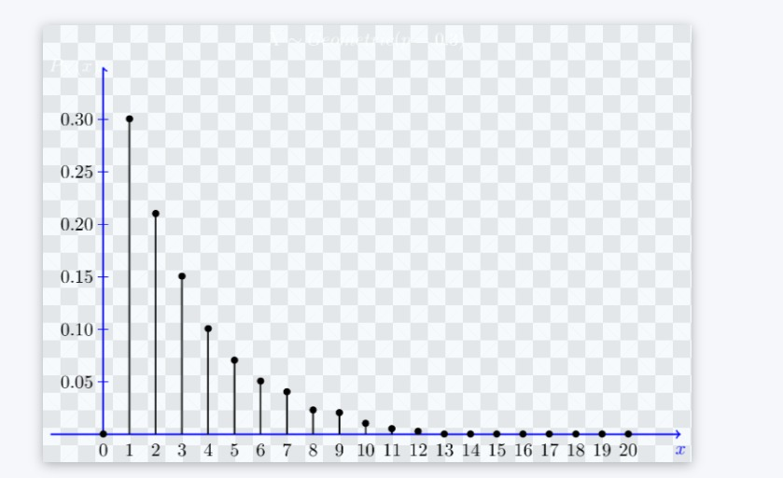
cont……
Bernoulli: Binary outcomes (success/failure).

Slide 11
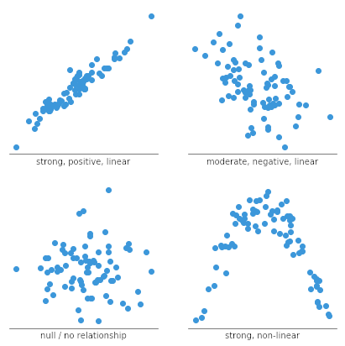
Distribution & Visualization
Scatterplots: Show relationships between variables.

Slide 12
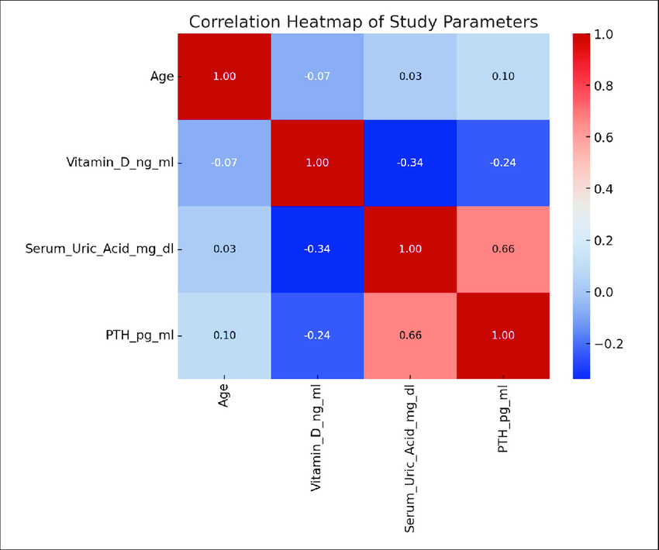
cont…….
Heatmaps: Display correlation strengths.

Slide 13
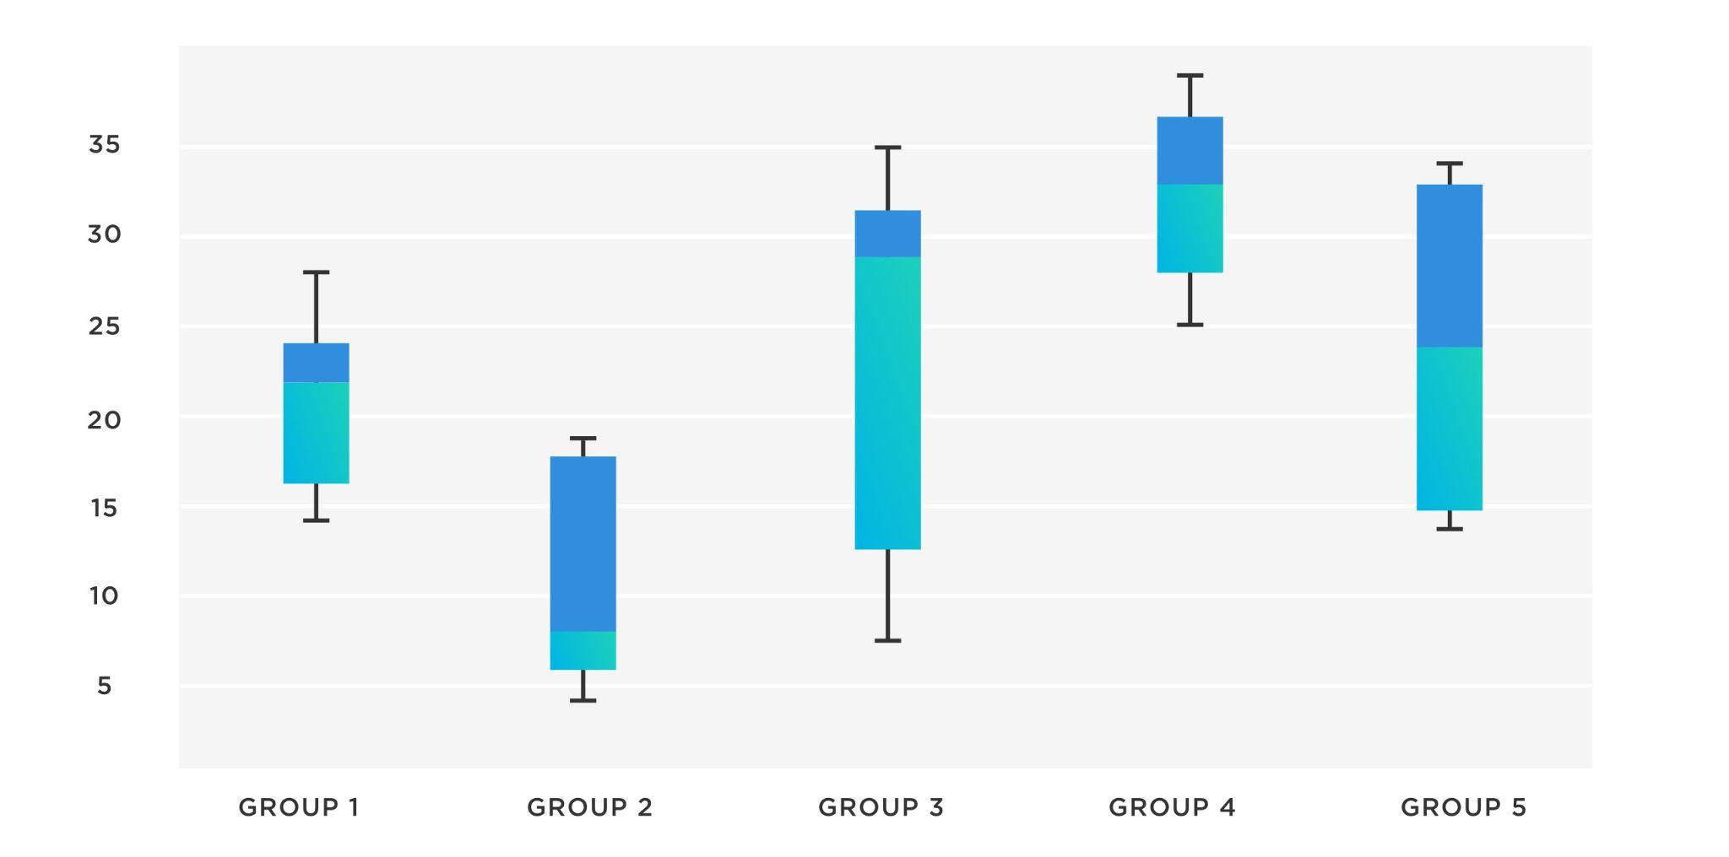
cont……..
Box Plots: Data distribution insights.

Slide 14
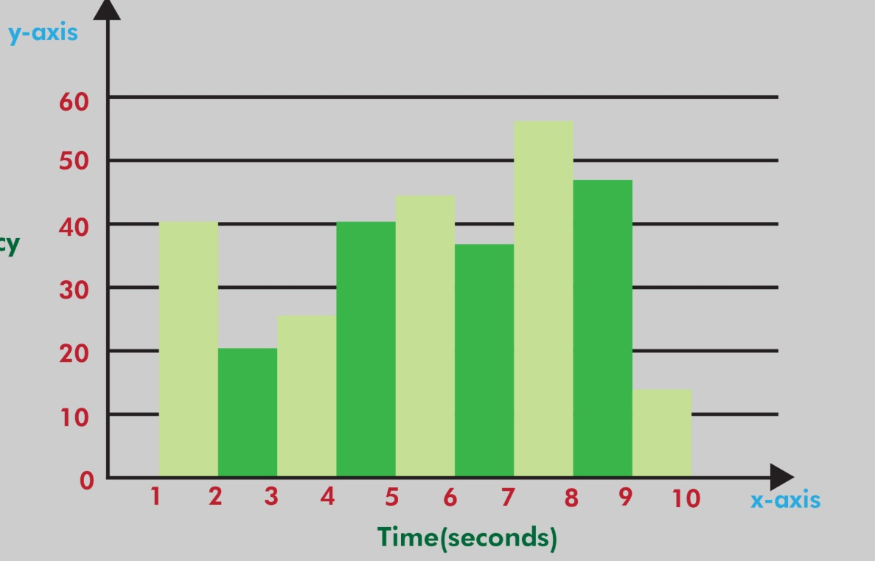
cont…….
Histogram

Slide 15
Prior vs Posterior Probability
Prior Probability: Initial belief before new evidence.
Posterior Probability: Updated probability after new evidence (via Bayes' Theorem).
Example: Weather prediction before and after new satellite data.

Slide 16
Statistical Models for Structured and Unstructured Data
Structured Data: Uses traditional models (e.g., Linear Regression, Decision Trees).
Unstructured Data: Uses advanced models (e.g., Neural Networks, NLP techniques).
Example: Sales data (Structured) vs Social Media Text (Unstructured).

Slide 17
Maximum Likelihood Estimation (MLE)
It is widely used in regression, classification
Often used to solved using optimization techniques like Gradient Descent
Gradient is a fancy word for Derivation

Slide 18
cont……
Example: Estimating mean and variance of a dataset.
Variance (σ²): How far values are from the mean is called as Variance

Slide 19
Importance of AI & Big Data
Enhances decision-making processes.
Drives automation and efficiency.
Facilitates real-time insights for businesses and governance.
Improves quality of life through predictive analytics

Slide 20
Impact on Healthcare
AI-powered diagnostics and predictive analysis.
Personalized medicine and treatment recommendations.
Efficient management of healthcare records and patient data.
Disease outbreak prediction and prevention.

Slide 21
Impact on Finance
Fraud detection and risk management.
Automated trading and personalized financial services.
Credit scoring and loan approval automation.
Chatbots for customer service in banking.

Slide 22
Impact on Education
Personalized learning experiences through AI-driven platforms.
Automated grading and assessment tools.
Virtual tutors and AI-powered education assistants.
Data-driven policy decisions for better curriculum design.

Slide 23
Impact on Smart Cities & Governance
AI-enabled traffic management and transportation planning.
Smart energy management and sustainability initiatives.
Predictive policing and crime analysis.
Digital governance and citizen engagement through AI-powered chatbots.

Slide 24
Ethical Considerations & Challenges
Data privacy and security concerns.
Bias in AI algorithms and decision-making.
Job displacement due to automation.
Regulation and policy framework for responsible AI usage.

Slide 25
Career Map: AI & Big Data Analytics
Entry-Level: Data Analyst, AI Research Assistant
Mid-Level: Machine Learning Engineer, Data Scientist
Senior-Level: AI Architect, Chief Data Officer
Specializations: NLP Engineer, Computer Vision Engineer, AI Ethics Consultant

Slide 26
Q&A
Questions and Discussions

